Slide 1
STAT 50 04/08/2021 Review

Slide 2




Slide 3
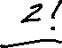

Slide 5
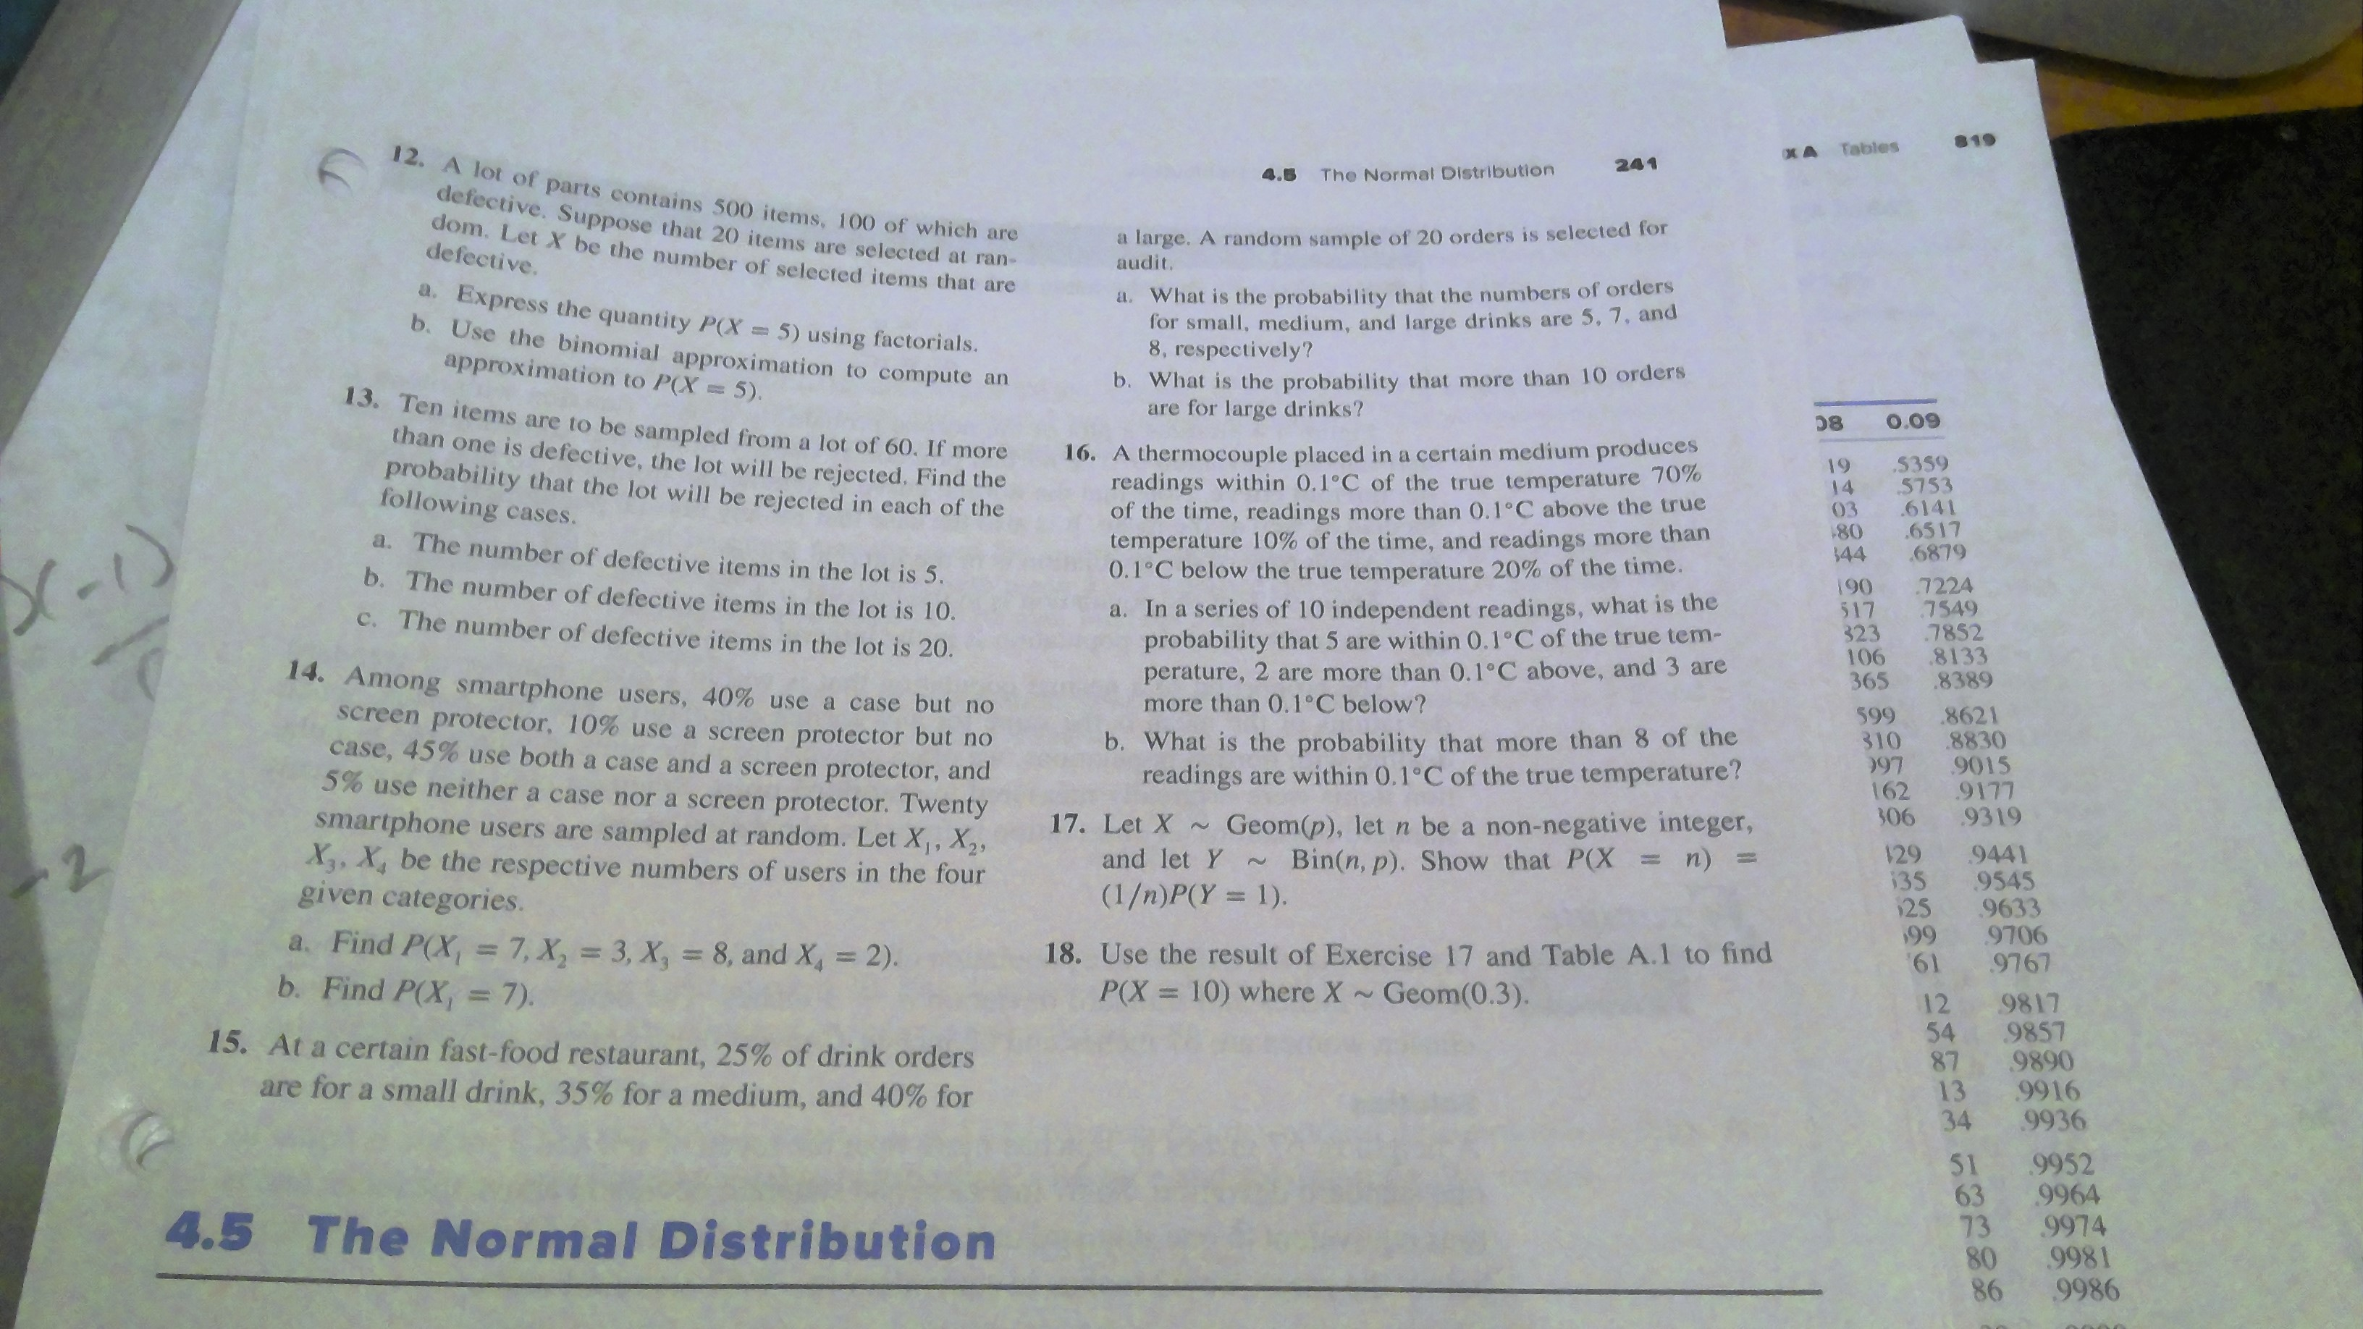

Slide 6
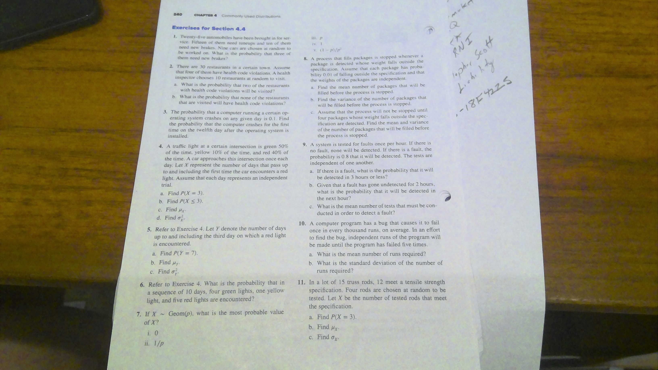

Slide 7
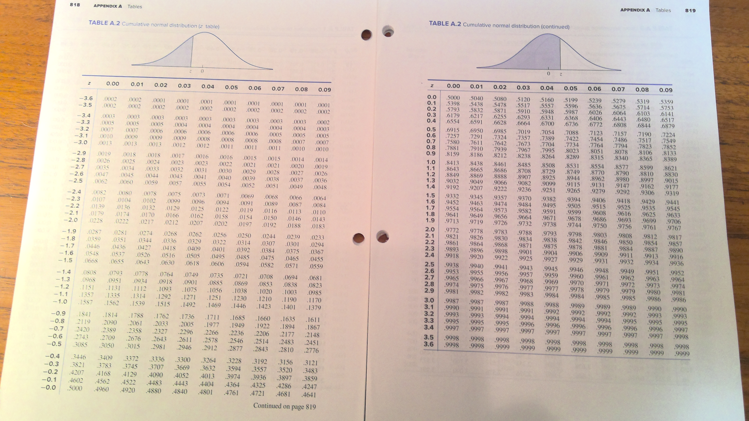

Slide 8







































Slide 9













Slide 10









Slide 11




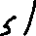



Slide 12






Slide 13








Slide 14


Slide 15







Slide 16





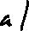







Slide 17





Slide 18





Slide 19


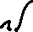

Slide 20









Slide 21





Slide 22








Slide 23











Slide 24







Slide 25







Slide 26











